Slide 1


SkyCASt: A weather forecast app
This app is designed to forecast weather condition of a city and advise resources to the clerks needed in different weather situation.

Slide 2
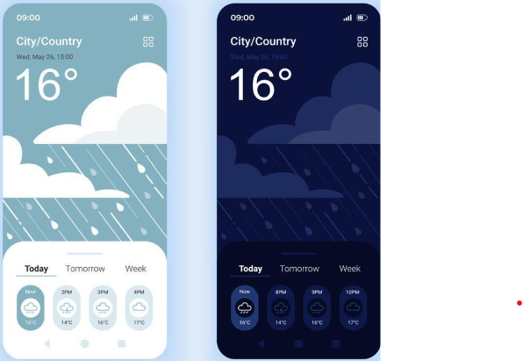
Application features
Different modes:
1. It forecast a weather condition for a week, precipitation, air quality index, Humidity, and visibility.
2.This application suggest city service clerks on what winter weather condition what resources are required to overcome the situation.

Slide 3
Benefits
City weather service department will be advised by this web application what resources (Plow truck, Sand trucks and Salt truck) are required and how much are needed to be dispatched.
Preparation and Planning : By examining weather forecasts, users may more efficiently arrange their activities like outdoor events, travel plans, also it help user to decide what to wear. So, knowing the weather in advance helps with better preparation.
Safety: By informing the public of severe weather occurrences such as storms, hurricanes, or extremely low temperatures, weather forecasts help to ensure public safety. This enables individuals to take the appropriate safety measures and evacuates if needed.

Slide 4
What this application does?
There are three type of weather : 1. Snow
2. Ice
3. Mixed(Combination of both snow and ice)
But this application is compatible to the all three-weather mentioned above.
Firstly, this application works or give alerts to the service clerk on two factors : Precipitation accumulation and temperature
App will suggest resources needed as per the weather condition : Plow trucks, Sand trucks and Salt trucks to the winter weather service department..
.

Slide 5
For example :
If precipitation is below or equal to 3.5cm , it would be a normal condition app and no action will be required in any temperature condition.
If app predict the precipitation will going to be >3.5 – 5.75cm, app will send an alert to the plow trucks team that 1 plow truck will be required under any temperature , however if temperature is below -15.0, 1 sand truck will be needed.
Similarly, as precipitation increases, and temperature decreases as required resources and application rate of vehicle changes.
Overall, by this application the city service clerks will get help in choosing resources on what weather condition.

Slide 6

Marketing & Customization

Slide 7
Marketing
This app is continuously doing its branding through social media by creating a social media profile and uploading content related to weather updates, tips and interesting facts.
This app will partner with weather influencers or individuals to promote the application.
Encourage users to leave positive reviews on app stores..

Slide 8
Customization
Allow users to customize their default location or set multiple location for weather forecast.
Provide option for users to choose preferred units for temperature, precipitation, wind speed and many more.
Allow users to customize the app’s theme and background images.
Allow users to customize weather alert notification based on their preference.(for example : service clerk will automatically get alerted if there will be any worst weather condition.)

Slide 9
How will Company earn money?
Through special subscription : subscription includes ad-free experience , extended forecast periods and premium map features.
Through ad senses : Our platform will run add through which company will earn.

Slide 10
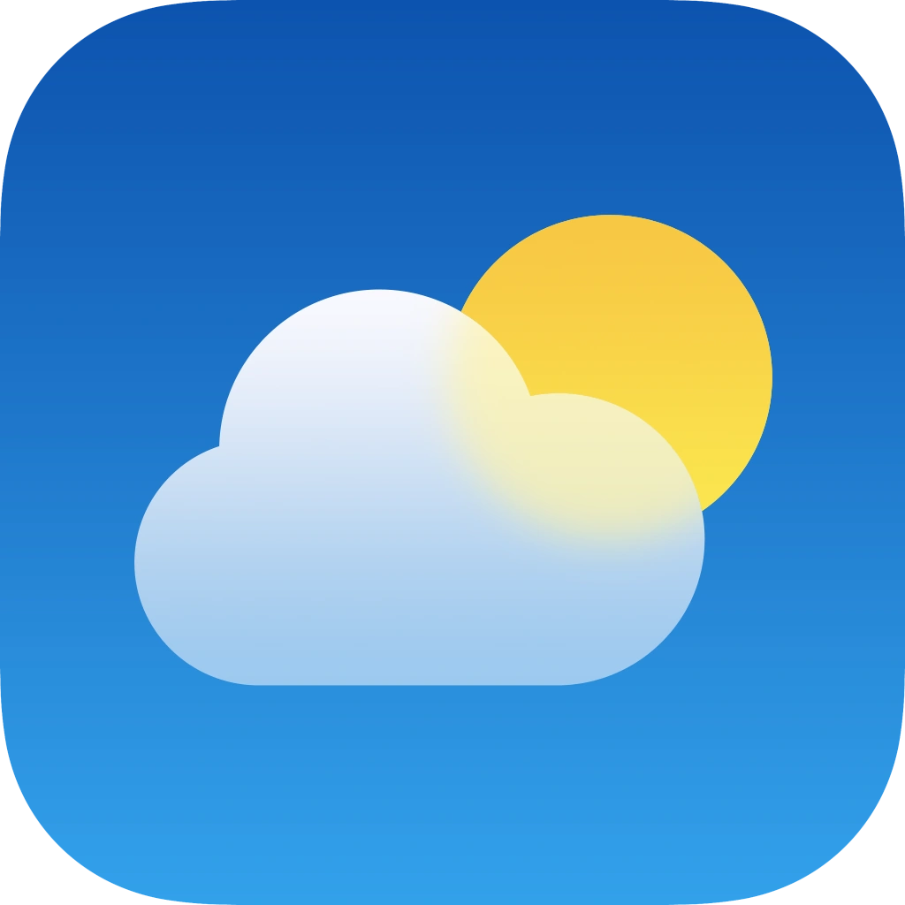
Conclusion
In summary , SkyCAST application specifically designed for the city service clerks to get advice regarding what resources they should use in what weather condition, which is a unique feature of the application. However, there are many other features like temperature, wind and precipitation forecasting and some customization features.

